Slide 1
Comprehensive Digital Marketing For Maruti Suzuki Motors India Ltd

Slide 2
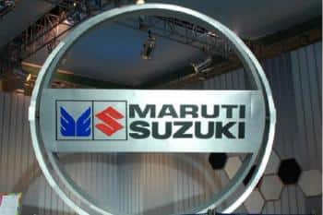
Presenting By
Team Lead:
J.Madhavi(LTVIP2023TMID1036)
Team Members
D.Hari priya
G.Dhanalakshmi
K.Gayathri
G.Sravani

Slide 3
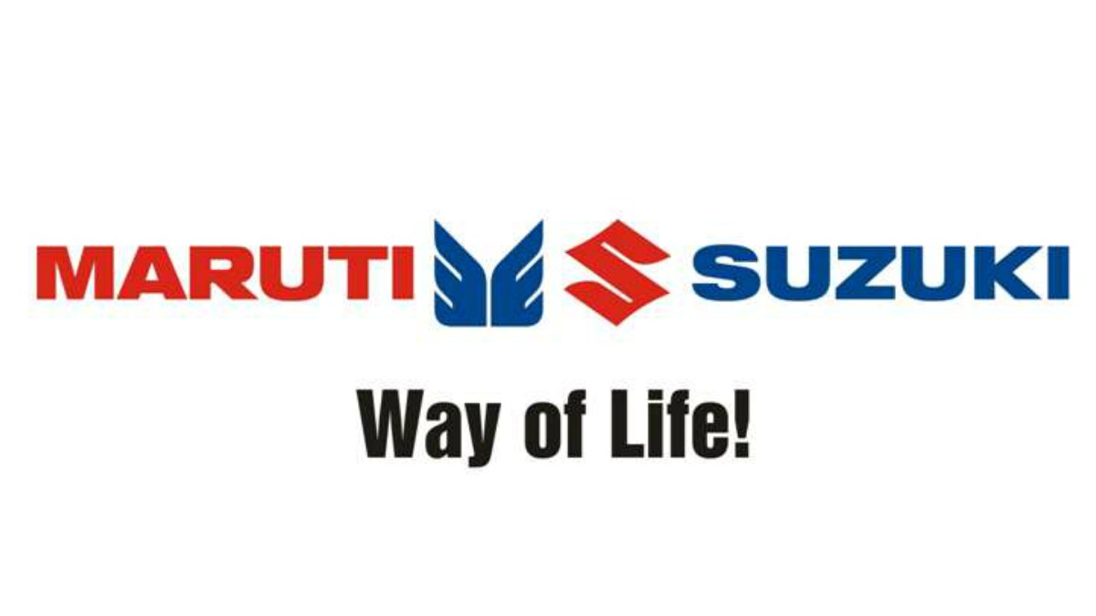
Maruti Suzuki Motors India Ltd
Maruti Suzuki India Limited (formerly Maruti Udyog Limited) is the Indian subsidiary of Japanese automaker Suzuki Motor Corporation.^{[8]} As of September 2022, the company had a leading market share of 42 percent in the Indian passenger car market.^{[9]} The company is known for making low-maintenance cars for the Indian market.

Slide 4
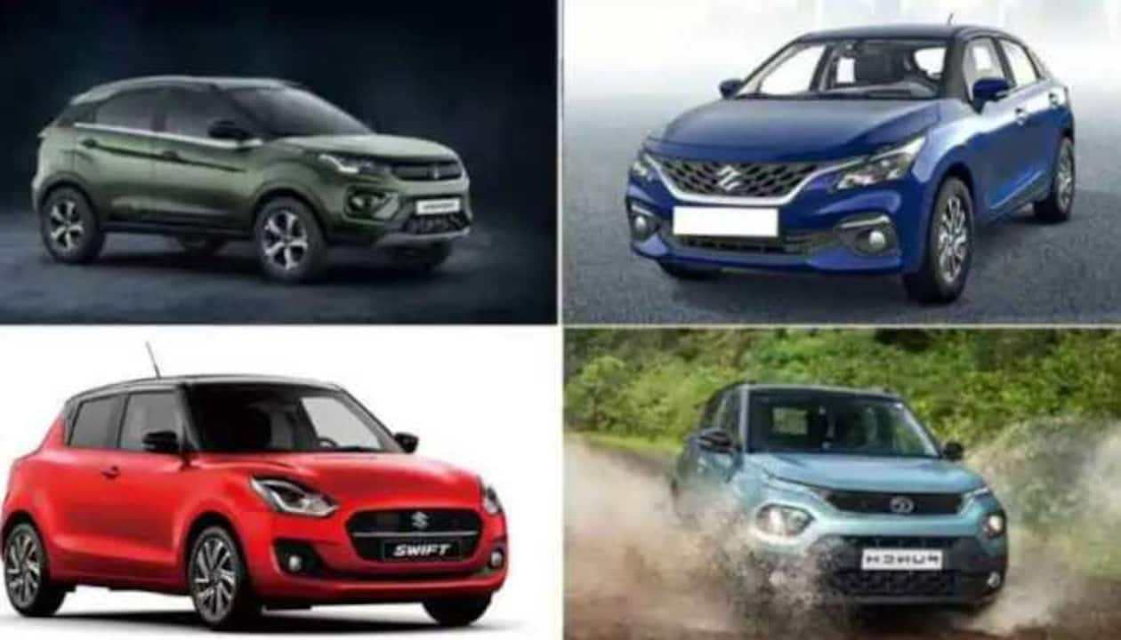

Slide 5
Brand Study,Competitor Analysis & Buyer’s/Audience‘s Persona
•Research Of Brand Identity:
Mission/Values:Maruti Suzuki’s mission statement says, ”To be The Leader in the Indian Automobile Industry, Creating Customer Delight and Shareholder’s Wealth; A pride of India.“
•Modernization of the Indian Automobile Industry. - Developing cars faster and selling them for less. - Production of fuel-efficient vehicles to conserve scarce resources. - Production of large number of motor vehicles which was necessary for economic growth. - Market Penetration, Market Development Similarly Product Development and Diversification. - Partner relationship management, Value chain, Value delivery network

Slide 6
USP:Maruti only have to look at the US markets where the American manufacturers were the dominant force but within no time has the competition caught up and infact even overtaken them.Hopefully Maruti gets the message soon and pulls up its socks.For starters it needs a good PR campaign.
•Honda is playing the environment card,Toyota reliability and Skoda luxury[yes that's the tag they are using in India,along with build quality] but what is one term you could associate Maruti Suzuki cars with.Cheap perhaps but competition is fast catching up with the company and soon we will have cheaper cars than even the Maruti 800[Bajaj-Renault,Hyundai,Tata motors].
•Maruti has car models in every segment with a wide price range to choose from, apart from being the most reliable name in Indian automobile market.
•With rising income levels the cheap cars tag will not really be such an important one,besides when the competition would provide cars for the mainstream market there is a very big risk that consumers would shift over to the more fashionable manufacturers than sticking with Maruti Suzuki ,even if the competition and Maruti Suzuki cars are from different sigments.

Slide 7
•Analyzing Brand Identity:
Tagline:We have changed our tagline from ‘Count on Us’ to ‘Way of Life’.
Logo:In 2011 all black elements were removed from the Maruti Suzuki logo, and now it was all blue and red, drawn against a plain white background, with no framing. Sometimes the bright logo got accompanied by a bold title case motto “Way of Life!” Set in a thick yet narrowed sans-serif, in black. The main part of the badge was set in a straight horizontal line, with the red “Maruti” lettering or snark followed by the blue-winged “M” emblem, the red Suzuki “S” icon, and the solid blue Suzuki logotype in the corporate style.

Slide 8
•Innovation:Maruti Suzuki as a brand has the maximum number of cars that are targeted towards the masses, budget-friendly, and fuel-efficient. While every other carmaker in the country is trying to launch an electric vehicle in the market, Maruti Suzuki seems to have no plans to enter the EV segment.
Values:Customer Centricity: Focusing on delivering products and services that meet the needs and expectations of their customers.
Quality and Reliability: Commitment to producing high-quality vehicles that are dependable and safe.
Digital Transformation:Maruti Suzuki Motors India Ltd was actively engaged in digital transformation efforts. They were adopting various technologies to enhance their operations, customer experience, and overall efficiency. Some aspects of their digital transformation might include:

Slide 9
Smart Goals:
SMART" goals are specific, measurable, achievable, relevant, and time-bound. Here are some hypothetical examples of SMART goals for Maruti Suzuki Motors India Ltd
Increase Market Share: Achieve a 5% increase in market share in the compact car segment by the end of the fiscal year 2023.
Enhance Customer Satisfaction: Attain a customer satisfaction score (CSAT) of 85% or above in the after-sales service department by implementing customer-centric initiatives within the next 12 months.
Improve Sustainability Practices: Reduce carbon emissions by 10% across all manufacturing facilities compared to the previous year, While increasing the use of sustainable materials in vehicle production by 15% by the end of 2023.
Strengthen Dealer Network: Expand the network by adding 50 new dealerships in Tier II and Tier III cities within the next 18 months, thereby increasing accessibility and penetration in untapped markets.
Innovate in Electric Vehicles (EVs): Launch two new electric vehicle models and achieve a 20% increase in EV sales compared to the previous year by the end of 2023, promoting the shift towards sustainable mobility solutions.

Slide 10
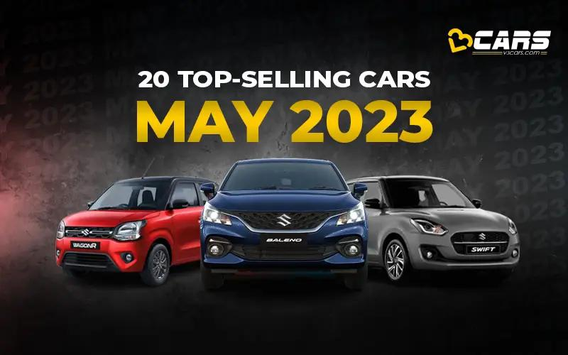
•KPIs of Maruti Suzuki Motors:
Sales Volume: The number of vehicles sold over a specific period.
Market Share: The percentage of the total automotive market that Maruti Suzuki holds.
Revenue and Profit Margins: Total income generated and the percentage of profit earned from sales.
Customer Satisfaction Index (CSI): Feedback and ratings from customers regarding their satisfaction with the company'sproducts and services.
Customer Retention Rate: The percentage of customers who continue to purchase Maruti Suzuki vehicles over time.
Production Efficiency: Measures like the number of vehicles produced per unit of time and the effectiveness of production process.

Slide 11
Competitor Analysis:
Competitors to Maruti Suzuki Motors india ltd are:
Competitor 1:Tata Motors
•USP:They recognised that the strength and safety of a vehicle should be the top priority for car buyers. Tata aimed to disrupt the market dominated by Maruti by introducing safety as their unique selling proposition (USP).
•Online Communication:The entire sales process is completed virtually using online communication tools such as emails, WhatsApp and video calls.
•Swot Analysis:
Strengths; Diverse Product Portfolio: Tata Motors has a wide range of products, including passenger cars, trucks, buses, and commercial vehicles. This diversity helps them cater to various market segments.
Global Presence: The company has a presence in over 170 countries, making it one of the largest automotive manufacturers in the world.

Slide 12
Weaknesses; Dependence on Economic Conditions: Tata Motors' performance is heavily influenced by economic conditions. In times of economic downturns, demand for automobiles tends to decrease.
Opportunities; Growing Electric Vehicle Market: With the global shift towards electric vehicles, Tata Motors can capitalize on this trend by expanding its EV offerings.
Emerging Markets: Expanding into emerging markets with a rising middle class, like India and parts of Africa, presents significant growth opportunities.
•Threats; Regulatory Changes: Stringent emission norms and changing government policies can significantly impact the automotive industry. Adapting to these changes is crucial.
Supply Chain Disruptions: Events like natural disasters, political instability, or global pandemics can disrupt the supply chain, affecting production and delivery schedules.

Slide 13
•Competitor 2:Honda Cars India
USP:The USP (Unique Selling Proposition) of Honda is the combination of reliability, fuel efficiency, and advanced technolog. Ashok Singh. Director (2007–present) Author has 1.7K answers and 1.7M answer views 4y.
•Online Communication:Email: For formal communication, updates, reports, and documentation sharing.
Instant Messaging Platforms (e.g., Slack, Microsoft Teams): For team collaboration, discussions, and sharing files in real-time.
Video Conferencing (e.g., Zoom, Google Meet): For virtual meetings, presentations, and discussions with teams or clients.
•Swot Analysis:
Strengths:Brand Reputation: Honda is globally recognized for its quality, reliability, and innovation in the automotive industry.
Technological Innovation: Known for advanced engineering and innovation, Honda often introduces cutting-edge technologies in their vehicles.

Slide 14
Weaknesses:Limited Market Share in India: Faces stiff competition from other established automakers, resulting in a relatively smaller market share.
Higher Price Range: Some Honda models are perceived as being relatively more expensive compared to competitors in the same segment.
Opportunities:Growing Demand for Electric Vehicles (EVs): The shift towards electric vehicles in India presents an opportunity for Honda to invest in and promote their EV offerings.
Expanding Product Lineup: Introducing new models or variants, especially in segments with high market demand, can attract a broader customer base.
Treats:Intense Competition: The automotive industry in India is highly competitive, with both domestic and international players vying for market share.
Regulatory Changes: Changes in emission norms, taxation policies, and other regulations can impact production costs and market competitiveness.

Slide 15
Competitor 3:Kia Motors India
USP:Design and Styling: Kia is known for its striking and contemporary design language. Their cars often feature bold and distinctive aesthetics, which appeal to a wide range of consumers.
Online Communication:Social Media Platforms: For customer engagement, announcements, and brand promotion.
Intranet/SharePoint: Internal platform for document sharing, announcements, and team collaboration.
•Swot Analysis
Strengths:Stylish Design and Aesthetics: Kia is known for its bold and eye-catching designs, which appeal to consumers looking for distinctive vehicles.
Feature-Rich Vehicles: Kia offers a range of vehicles equipped with advanced features, providing high value for customers.

Slide 16
Weaknesses:Relatively New to the Indian Market: Compared to well-established competitors like Maruti Suzuki and Hyundai, Kia is a newcomer to the Indian automotive scene.
Limited Product Portfolio: As of 2021, Kia's product lineup in India was relatively smaller compared to some of its competitors.
Opportunities:Expanding Product Portfolio: Kia has the opportunity to introduce new models or variants to cater to a wider range of customer preferences and needs.
Rising Demand for SUVs: The trend towards SUVs in the Indian market presents an opportunity for Kia, especially with their successful models like the Seltos.
Threats:Economic Uncertainty: Economic downturns, inflation, or currency fluctuations can affect consumer purchasing power and demand for vehicles.
Supply Chain Disruptions: External factors such as natural disasters or geopolitical tensions can disrupt the supply chain, impacting production schedules.

Slide 17
•Buyer’s/Audience‘s Persona:
Budget-Conscious Consumers: Maruti Suzuki is known for producing affordable and economical cars, making them a popular choice among middle-class families and individuals looking for cost-effective transportation.
First-Time Car Buyers: Many Maruti models are considered entry-level cars, making them a popular choice for individuals who are purchasing their first car.
Urban Commuters: Maruti cars are well-suited for city driving, known for their compact size, fuel efficiency, and ease of maneuvering through congested traffic.
Small Family Owners: Maruti Suzuki cars like the Swift, Baleno, and Dzire are preferred by small families due to their practicality, fuel efficiency, and affordability.
Value-Conscious Buyers: Customers who prioritize good value for money, reliability, and low maintenance costs are attracted to Maruti Suzuki's offerings.
Environmentally Conscious Consumers: Maruti Suzuki has also ventured into producing hybrid and CNG vehicles, appealing to individuals looking for eco-friendly transportation options.
Brand Loyalists: Maruti Suzuki has a strong brand presence in India, and many customers are loyal to the brand, often choosing to upgrade to newer Maruti models.
Business and Fleet Owners: Maruti offers a range of commercial vehicles suitable for businesses and fleet operations, emphasizing efficiency, low operating costs, and reliability.

Slide 18
SEO and keyword research
SEO Audit:
Maruti is one of the most successful automobile companies in India has worked immensely on optimizing its platform to rank on the search engine. Whenever someone searches for Keywords like “ Cars, Best Cars or anything related to Car and vehicles” the chances of results showing Maruti’s article are very high. And this is all possible because Maruti has put a lot of effort into SEO.
As per Ubersuggest, a keyword tool by Neil Patel, Maruti has a search volume of 135000 while 55837 people click on SEO results in India.
The average web page that ranks in the top 10 has 290 backlinks and a domain score of 75. These stats are really amazing.
Keywords that include cars or services provided by Maruti like’ ‘Nexa, Wagon R, Swift, celerio’ tell the search engines that these pages have the content related to these search queries.
.

Slide 19
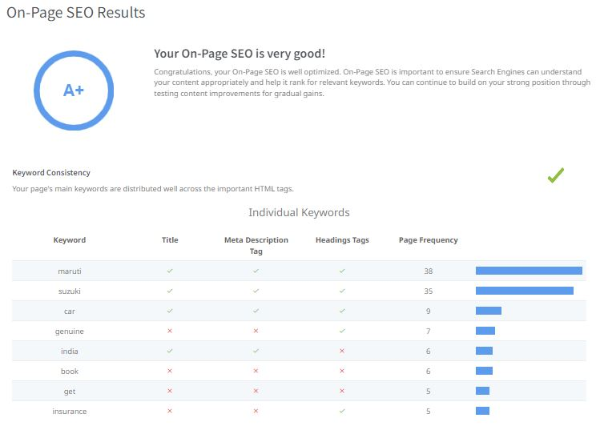

Slide 20
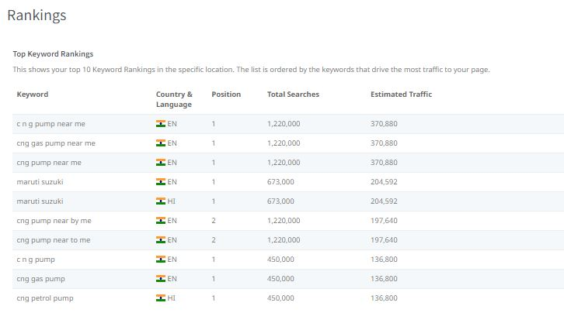

Slide 21
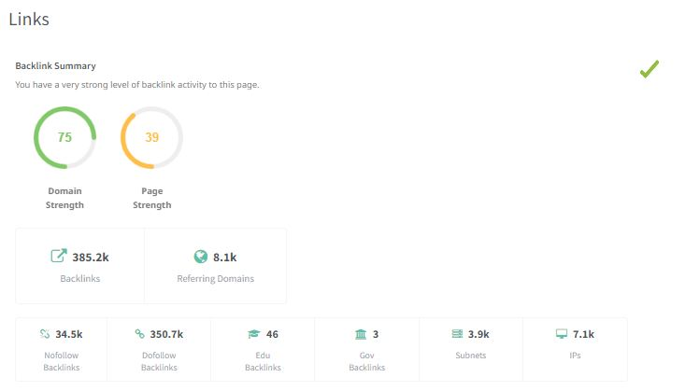

Slide 22
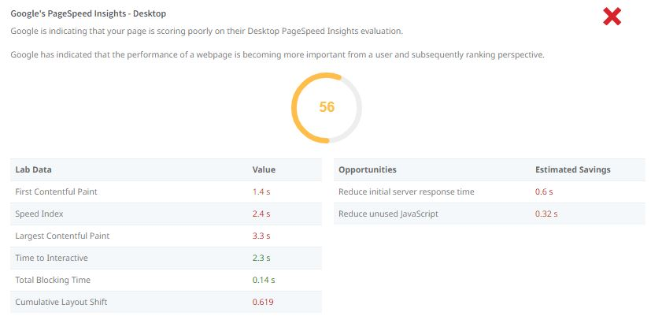

Slide 23
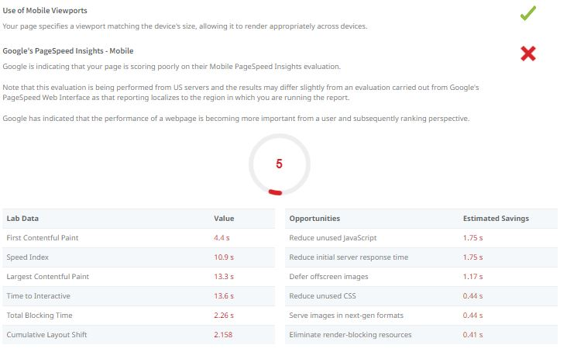

Slide 24

Keyword research
Keyword Research Objectives
Brand Visibility: Identify keywords that are associated with Maruti Suzuki's brand, products, and services to ensure the company appears prominently in search results.
Product Promotion: Target keywords related to specific car models, features, and benefits to attract potential customers interested in purchasing Maruti Suzuki vehicles

Slide 25
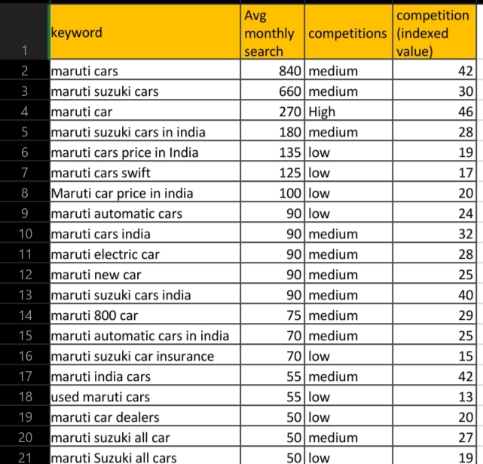

Slide 26
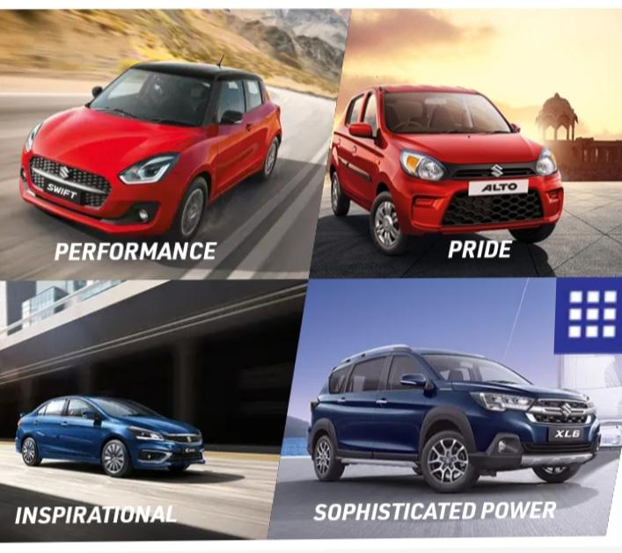

Slide 27
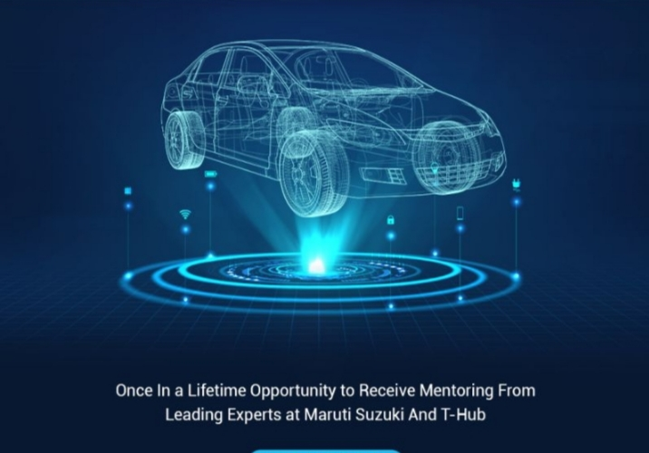
Seed Keywords for Maruti Suzuki Motors India Ltd
Maruti Suzuki
Maruti Suzuki India
Maruti cars
Suzuki cars India
Maruti Suzuki models
Maruti Suzuki dealers
Maruti Suzuki service centers
Maruti Suzuki prices
Maruti Suzuki offers
Maruti Suzuki latest models
Maruti Suzuki accessories
Maruti Suzuki maintenance
Maruti Suzuki spare parts
Maruti Suzuki warranty

Slide 28
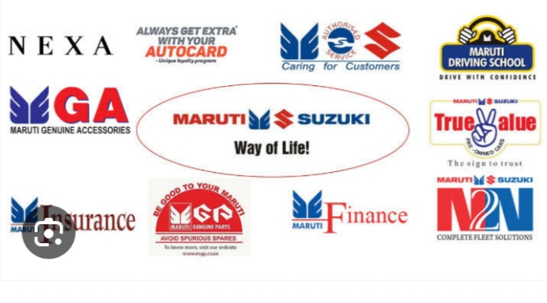
Competitors Keywords for Maruti Suzuki Motors india :
Hyundai India
Tata Motors
Honda Cars India
Toyota India
Mahindra and Mahindra
Ford India
Volkswagen India
Renault India
Kia Motors India
Nissan India
Skoda Auto India
Fiat India
Chevrolet India
•MG Motors India
Datsun India

Slide 29
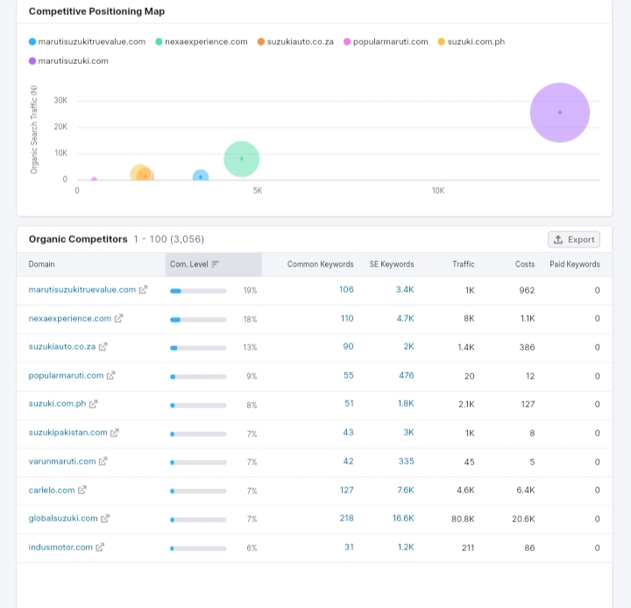

Slide 30
Long tail keyword Exploration
Maruti Suzuki Alto K10 2023 interior features"
"Maruti Suzuki Ciaz hybrid mileage comparison"
"Maruti Suzuki Nexa showroom offers in Bangalore"
"Maruti Suzuki Wagon R electric variant launch date"
"Maruti Suzuki Swift vs. Hyundai Grand i10 Nios comparison"
"Maruti Suzuki S-CNG availability in Pune"
"Maruti Suzuki Vitara Brezza ground clearance for off-roading"
"Maruti Suzuki Arena financing options for first-time buyers"
"Maruti Suzuki Ignis urban compact car safety ratings"
Maruti Suzuki XL6 boot space dimensions"
These long tail keywords further target specific aspects of Maruti Suzuki Motors India Ltd.

Slide 31
On Page Optimization
Title Tags and Meta Descriptions: Ensure each page has a unique, descriptive title tag and meta description that includes relevant keywords. These are what users see on search engine results.
Images Optimization: Compress and optimize images for web use. Use descriptive file names and alt tags to improve accessibility and SEO.
URL Structure: Create clean, user-friendly URLs that are descriptive and contain keywords. Avoid using random strings of numbers or characters.
Content Quality and Relevance: Produce high-quality, original content that addresses the needs and interests of the target audience. This could include informative articles, product descriptions, and FAQs.
Mobile Optimization: Ensure the website is mobile-friendly and offers a seamless user experience on various devices.

Slide 32
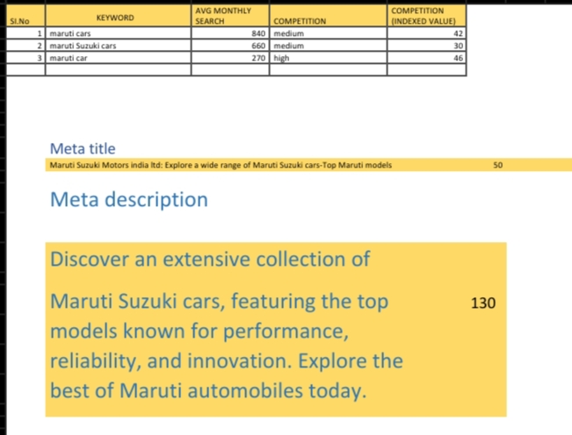

Slide 33
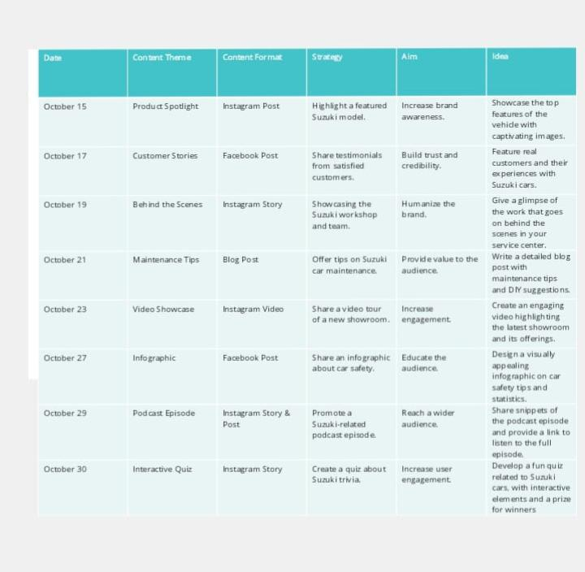
Content Ideas and Marketing Strategies

Slide 34
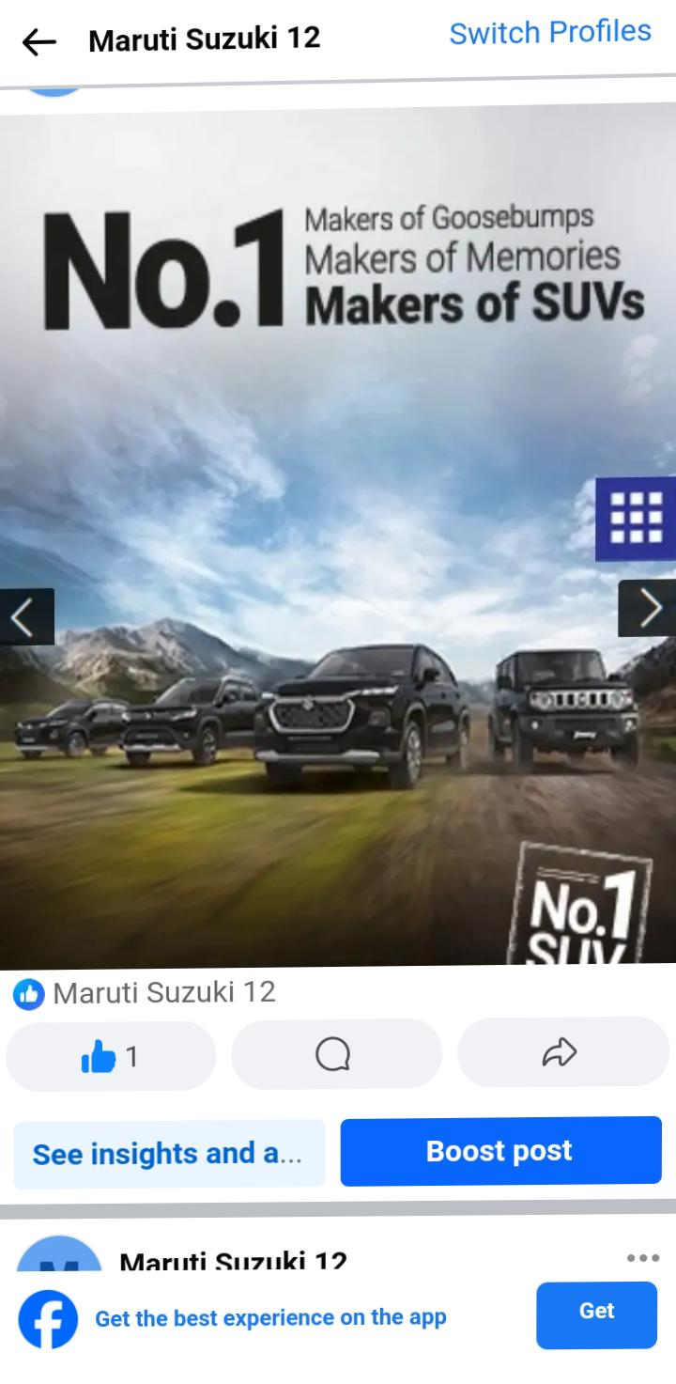
Post creation
Format 1:Interactive Polls and Quizzes
Idea 1: Fuel Efficiency Quiz Caption: "Test your knowledge about fuel efficiency! Comment below with your answer. Stay tuned for the correct answer! 🚗💨 #MarutiMileageMaster #QuizTime"
Idea 2: Model Preferences Poll Caption: "We want to know: which Maruti Suzuki model do you dream of driving? Vote now and let your choice be heard! 🗳️✨ #DreamCarPoll"
Call to Action (CTA): "Visit our website to explore more about your favoritemodel. Link in bio!“
https://www.facebook.com/61552649330420/posts/pfbid0cHzVBNhY7w4gw5BLGUexFyTKKjwxSZwjjUYn4RqtJTyCuoSaX4cp6Mud2i7jFGtl/?app=fbl

Slide 35
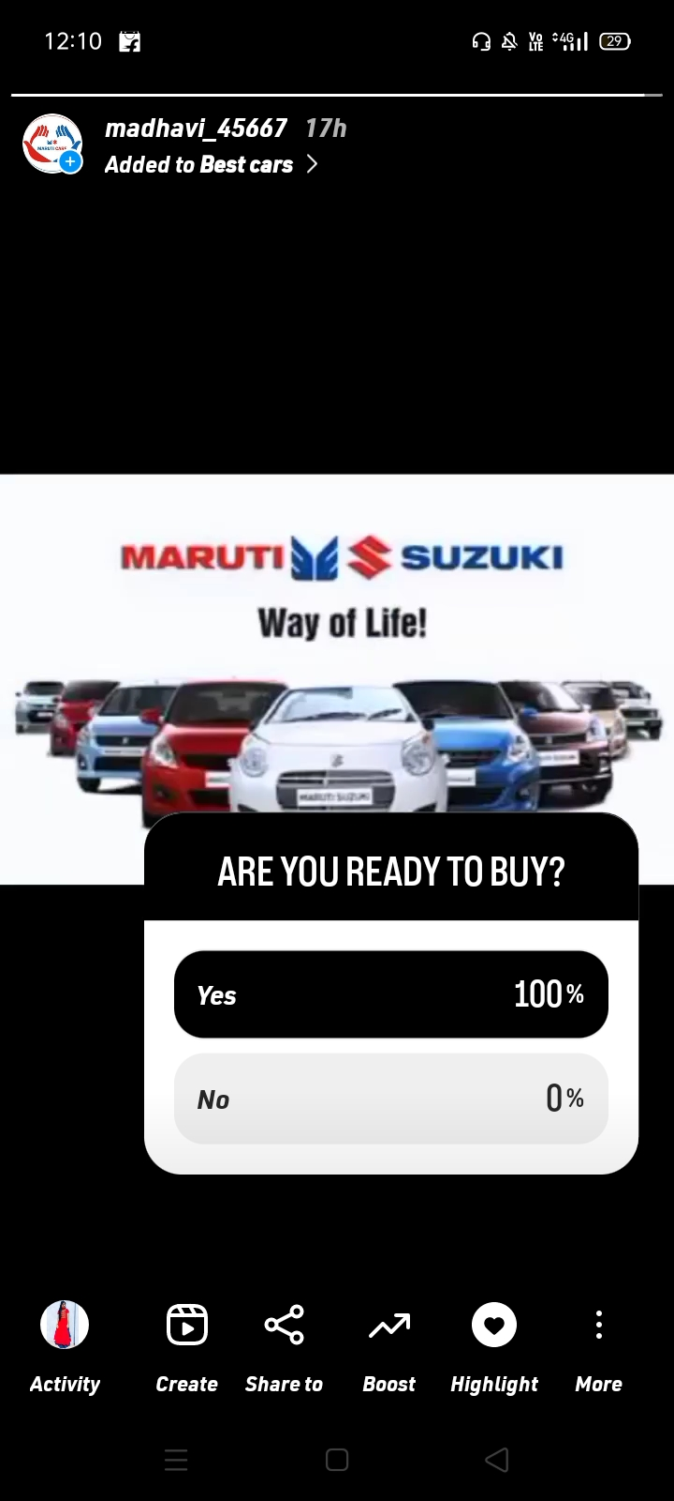
Format 2:Tips and How-To Guides
Idea 3: Monsoon Driving Tips Caption: "Stay safe and enjoy the monsoon drives with these expert tips. Swipe through and let us know which tip was most helpful! 🌧️🚗 #MonsoonDriveTips"
Idea 4: DIY Car Maintenance Caption: "Give your Maruti the care it deserves! Learn how to perform basic maintenance tasks at home. Watch the video and share your experience! 🧰🔧 #DIYCarCare"
Call to Action (CTA): "Visit our YouTube channel for more detailed tutorials. Link in bio link

Slide 36
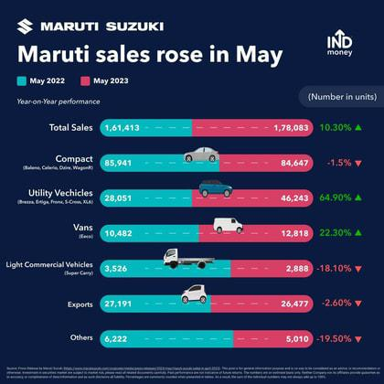
Format 3:Inspirational Customer Stories
Idea 5: Maruti Memories Caption: "Every Maruti tells a unique story. Share your cherished Maruti moments and inspire others. Use #MarutiMemories to be featured on our page! 📸🚗"
Idea 6: Testimonial Tuesday Caption: "This #TestimonialTuesday, we're sharing the heartwarming story of [Customer Name]. Their journey with Maruti Suzuki is truly special. Read it here! ❤️🌟 #HappyCustomer"
Call to Action (CTA): "Share your own story with us and let's create more wonderful memories together. Send us a message!"

Slide 37
Instagram story
Instagram story link:
https://instagram.com/stories/madhavi_45667/3213443649266190240?igshid=NjZiM2M3MzIxNA==
Hilight link:
https://www.instagram.com/s/aGlnaGxpZ2h0OjE4MDMwNTM0Njg4NjE4MTA3?igshid=NTc4MTIwNjQ2YQ==

Slide 38
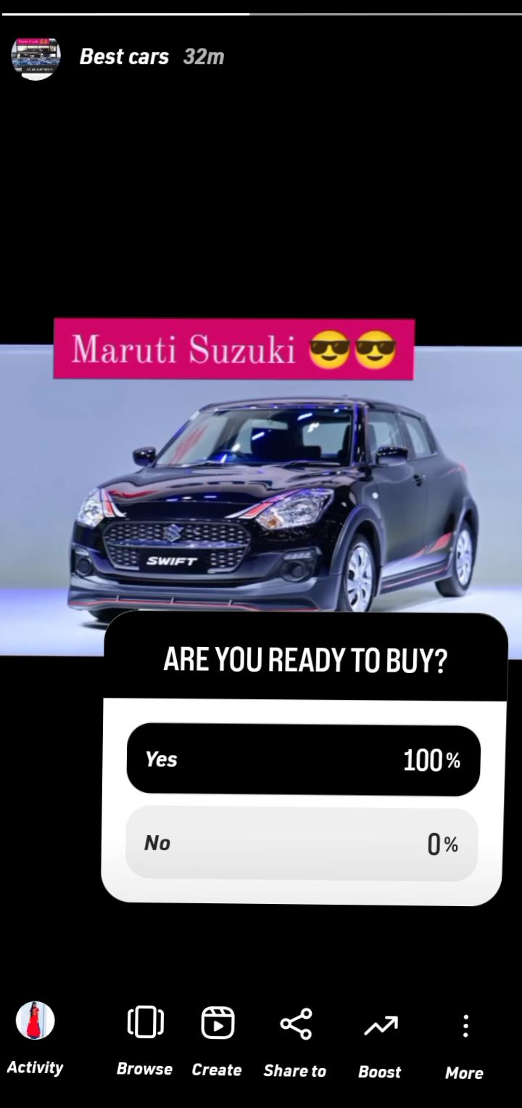
Instagram story

Slide 39
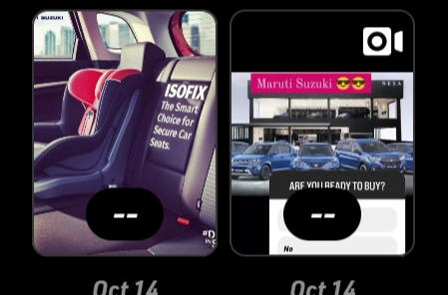
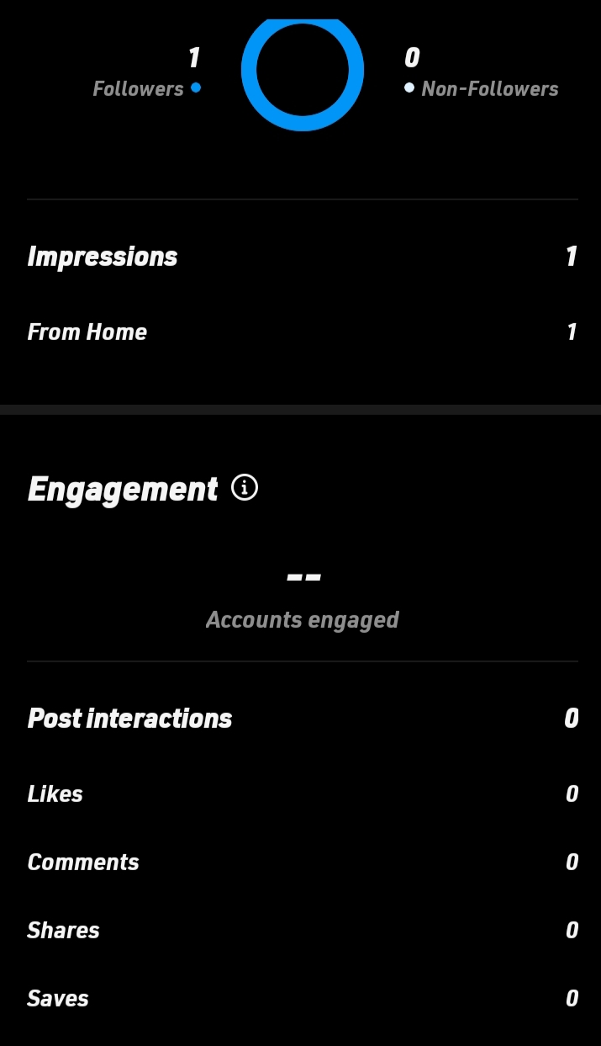
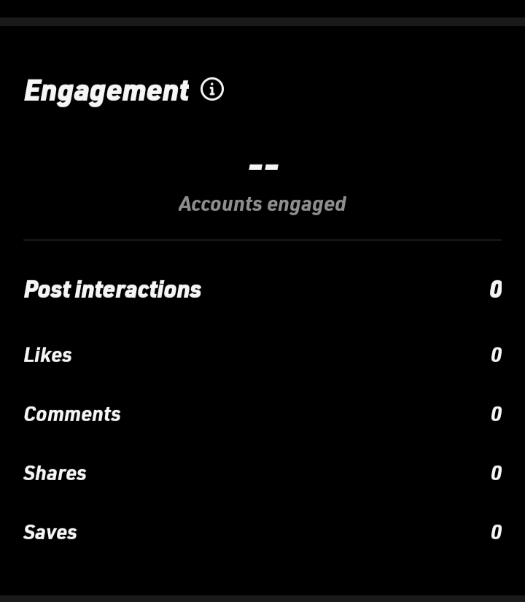
Insights
Top content based On reach:

Slide 40
Thank you

